Slide 1
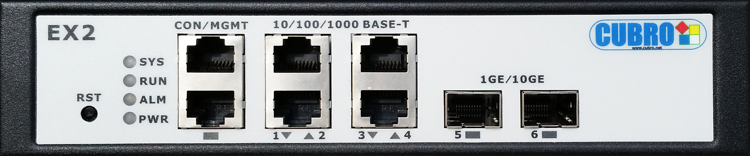
Packetmaster EX2
WEB GUI
Training
High Performance
Desktop Network Packet Broker
V 2.1.1.0

Slide 2
Content
This training is intended to enable users of the Cubro Packetmaster EX2 to deploy and manage it via the Web GUI.
The Web GUI is designed to work with all standard web browsers such as:
  Microsoft Internet Explorer
  Mozilla Firefox
  Google Chrome
  …

Slide 3
First Start
Connect to the EX2 via web browser
Download latest software version and upgrade the EX2
Change IP address configuration according to your requirements
Define Users
Define Port Settings
Define Functionality (Filter rules,…)

Slide 4

Default Configuration – EX2
Management Interface
  IP: 192.168.0.200
  Mask: 255.255.255.0
  GW: 192.168.0.1
Port Setup
  Port 1 to 4: Autoneg ON
  Port 5 to 6: 1G
Default Flows/Filters
  None
Web Login
  At 1st login user/password is NOT required.
  A superuser is defined by default but not active
    User: admin
    Password: cubro
      This user is a superuser with full rights.
ssh Login
  User: root
  Password: fucik1

Slide 5

EX2 Ports
Ethernet Management I/F for web GUI or SSH connection;
Default IP is 192.168.0.200/24
SFP/SFP+ Ports for 1G/10G
also 10G Base-T SFP supported
Base-T ports for 10M/100M/1000M
In the Web GUI under "Ports" - "Port Status" every defined Port as well as its port number is viewable.

Slide 6

Connection to EX2
Connect to your Cubro Packetmaster EX2 via the Management Interface
Enter the IP of the Packetmaster in your web browser (Factory default: 192.168.0.200)
Web Browser will not require a login with username and password after upgrade – more later
Ethernet Management

Slide 7
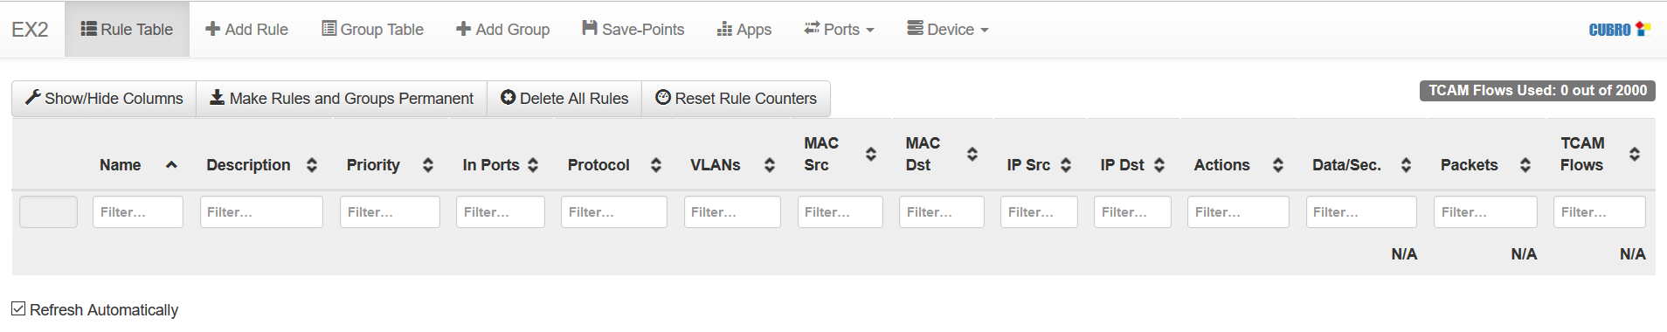
Web GUI Start-Up Screen
Rule Table
After login the Web GUI shows the active rules – "Rule Table"
The EX2 is usually delivered without any defined rules. Therefore the rule table will be empty.

Slide 8
General Settings

Slide 9
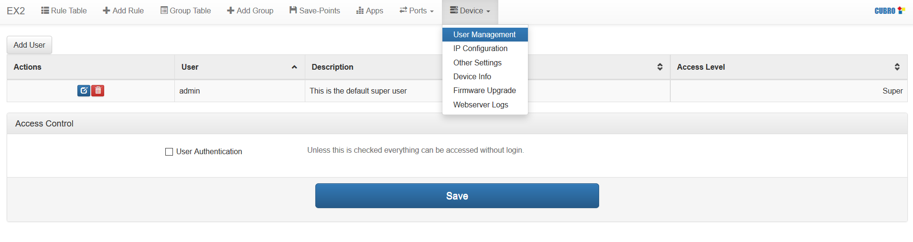
Device – General Parameters
Allows setting IP parameters of the management port, Upgrade the unit, Define Users for Web access,…

Slide 10
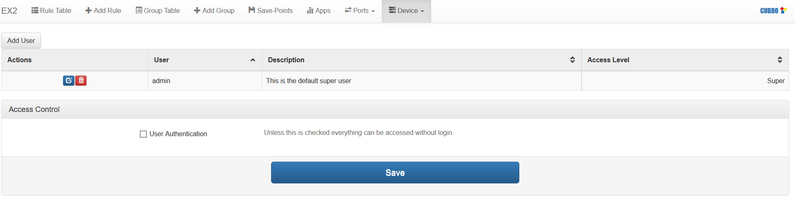
Device User Management - Overview
Add additional users – can only be done by a superuser
Save – whenever a new user is added or anything is changed the "Save" button must be clicked
Login by username/password enabled/disabled.
By default this is not active. When active logging in requires a username and password
By default the EX2 is delivered with a superuser with the following credentials:
  Username: admin
  Password: cubro
    This user is not active until checkbox is selected

Slide 11
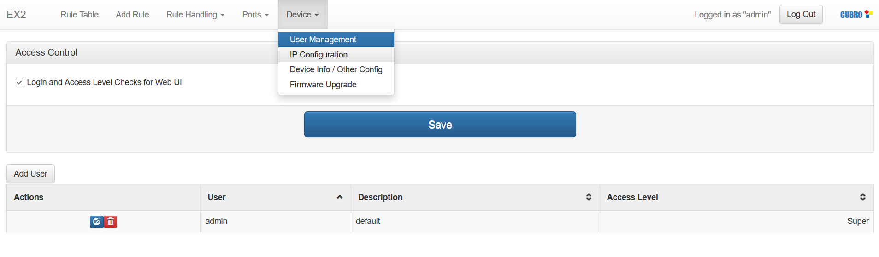
Device User Management – Add User
Save – whenever a new user is added or anything is changed the "Save" button must be clicked
Only a superuser can add/delete users
3 different levels of user can be created
  Superuser – with all rights
  Write – can change rules and templates. Can not create users, change port settings, IP config or upgrade the SW of the unit.
  Read – read only

Slide 12
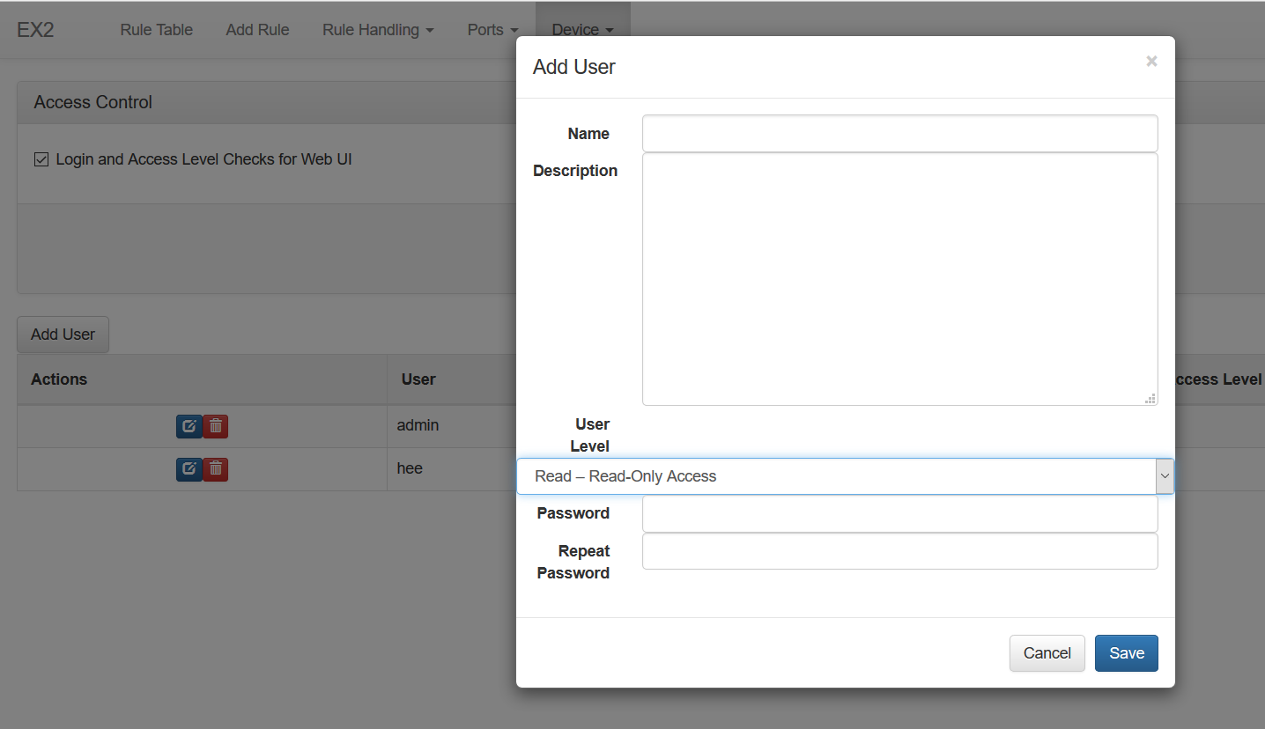
Device User Management – Add User
Username
Freeform description for easier identifcation of the user
User level – Superuser, Write and View
Password – min. 4 characters

Slide 13
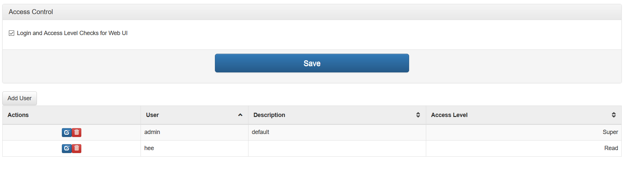
Device User Management – Delete/Change User
Change User
Delete User
Only a superuser can delete users
One superuser must remain active and therefore the last superuser can not be deleted.

Slide 14
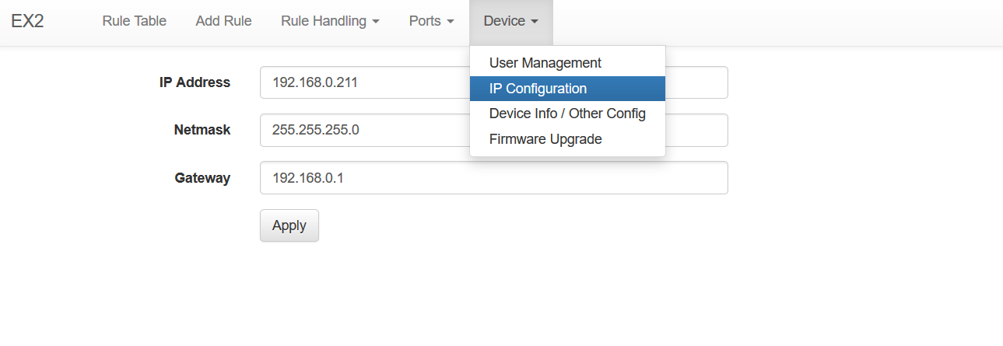
Device - IP Configuration
Configure Management Interface
  Set configuration for management interface
  When settings are changed the browser automatically connects to the new IP address

Slide 15

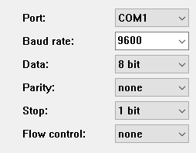

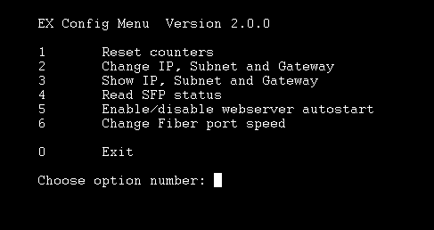
IP Setup – Rescue via Serial Interface
If the IP Address of the EX2 is unknown connect via Serial Console to the unit
  Serial Parameters
  CLI Commands

Slide 16
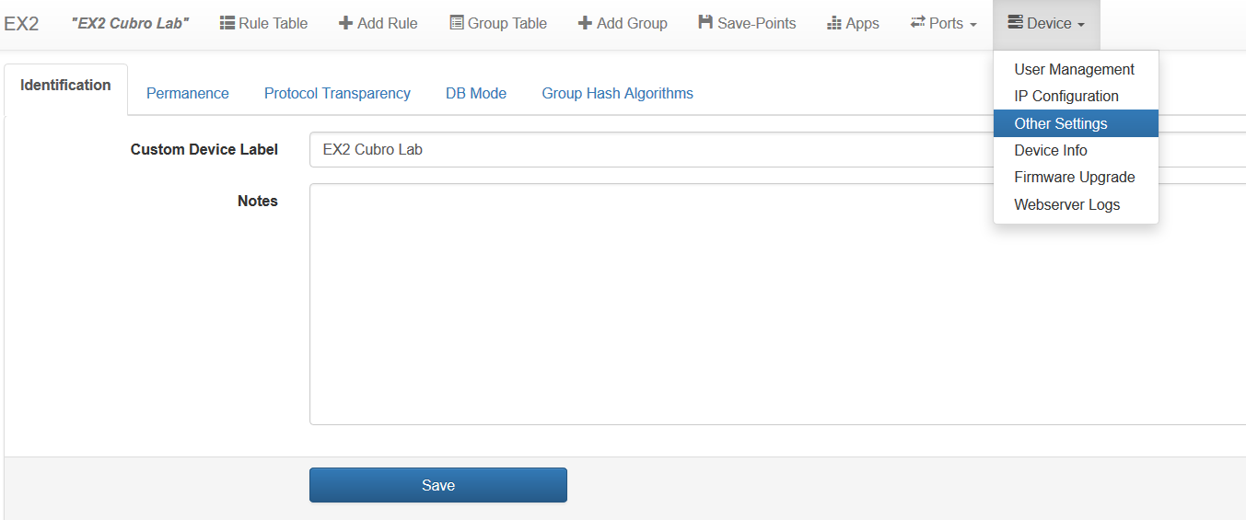
Device – Other Settings
When "Permanence" is checked rules are immediately saved into the Quicksave Save-Point once they are defined.
Set Layer2 and MPLS transparency – see chapter Transparency
Set “Standard Mode” with up to 2000 rules or “IPv6 Mode” with up 500 rules
Set load-balancing mechanism (calculation method) – see Chapter Load-Balancing
ID Tag that is displayed in the Web GUI

Slide 17
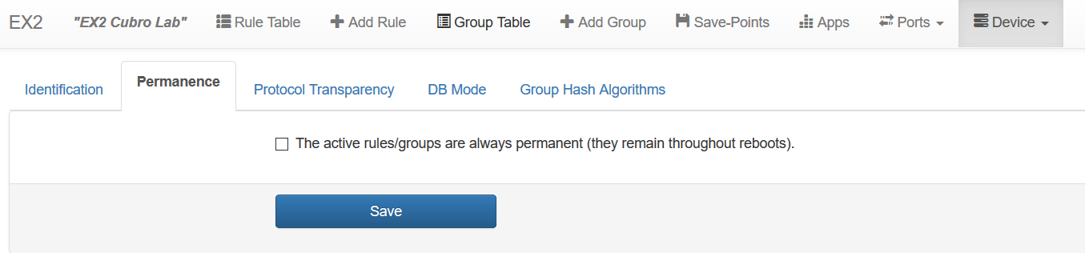

Permanence
If selected - rules and port groups are immediately saved in the Quicksave Save-Point when the "Apply Rule" button is clicked in the "+Add Rule" menu

Slide 18
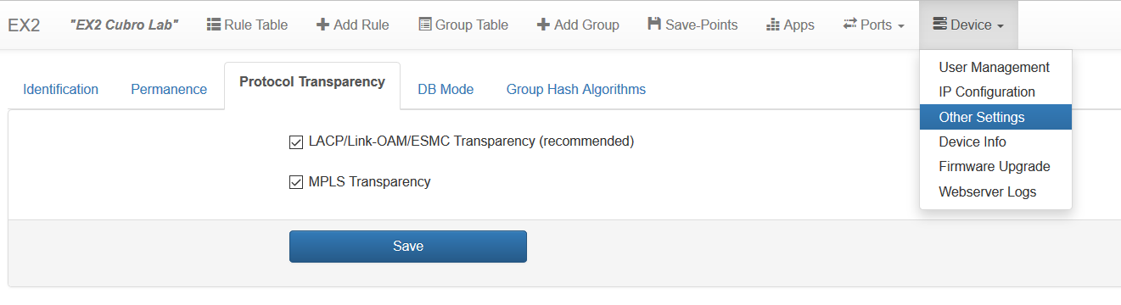
Transparency
The EX2 is a Network Packet Broker (NPB) and is able to analyze packets for filtering purposes; it is not a transparent
device such as a tap.
Some protocols such as Layer 2 Control Protocols (L2CP) and MPLS encapsulated packets might not pass through the EX2.
From Software Version 1.3.5.0 onwards the Web GUI of the EX2 offers a possibility to change the transparency mode.

Slide 19

LACP/Link-OAM/ESMC Transparency
Protocol | EX2 Transparency
STP | Yes | Yes
LACP | No | Yes
Link OAM | No | Yes
ESMC | No | Yes
PTP | Yes | Yes
LLDP | Yes | Yes
VDP | Yes | Yes
PE-CSP | Yes | Yes
PNAC 802.1x | Yes | Yes
SPB | Yes | Yes
MMRP | Yes | Yes
MVRP | Yes | Yes
MSRP | Yes | Yes
MIRP | Yes | Yes
PAgP | Yes | Yes
CDP | Yes | Yes
UDLD | Yes | Yes
VTP | Yes | Yes
DTP | Yes | Yes
ISL | Yes | Yes
PVST | Yes | Yes
RSTP | Yes | Yes
MSTP | Yes | Yes
GMRP | Yes | Yes
GVRP | Yes | Yes
STP_ULFAST | Yes | Yes
VLAN_BRDGSTP | Yes | Yes
Full transparency of L2 control protocols

Slide 20


MPLS Transparency
When the box is checked MPLS encapsulated packets are able to pass through the EX2. When not selected MPLS packets will be dropped.
MPLS tagged packets pass transparently through the EX2
MPLS tagged packets are dropped and do not pass through the EX2

Slide 21
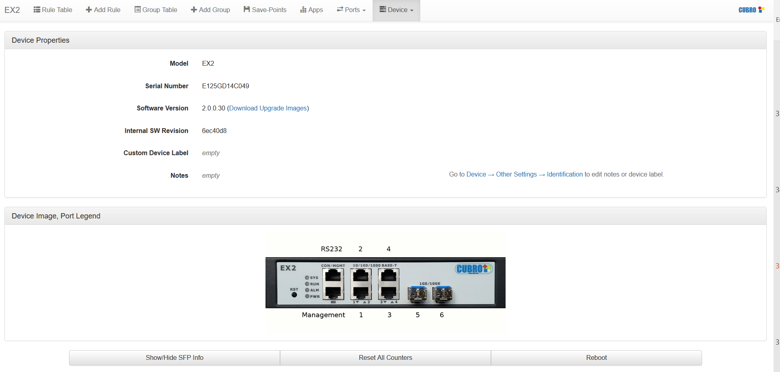
Device - Device Info
Direct link to the latest firmware version for download or visit the URL directly http://www.cubro.net/cubro/update/ex2/
Scroll down for more information

Slide 22

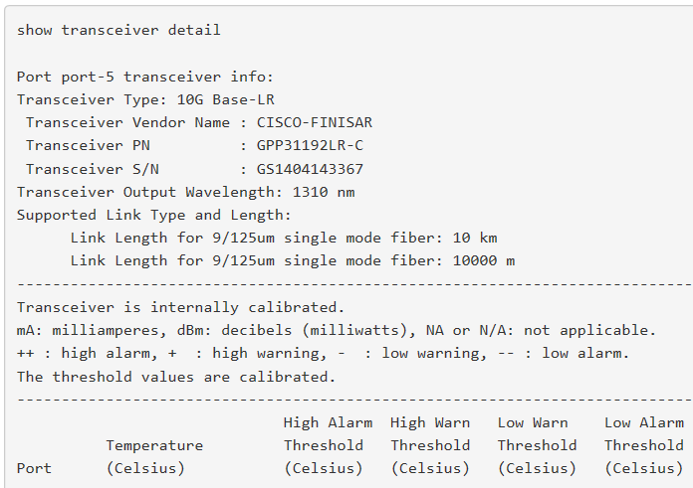
Device - Device Info
Clicking displays Transceiver Details
Vendor
Product number
Wavelength
max. Link length
Thresholds
Alarms
Temperature
Voltage
Current
Optical Power Tx
Optical Power Rx

Slide 23
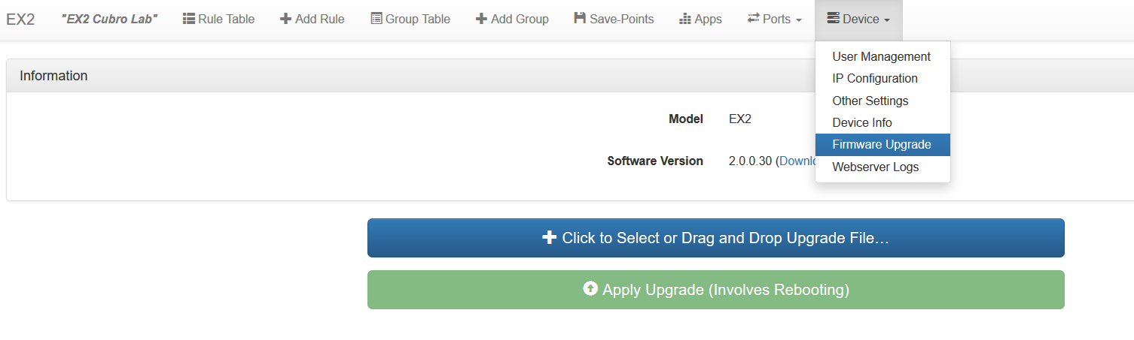
Device - Firmware Upgrades
Software is available from http://www.cubro.net/cubro/update/ex2/
Release Notes are available from http://www.cubro.net/cubro/update/CHANGELOG.txt
Select firmware file to be uploaded
Install uploaded firmware file

Slide 24
Port Settings

Slide 25
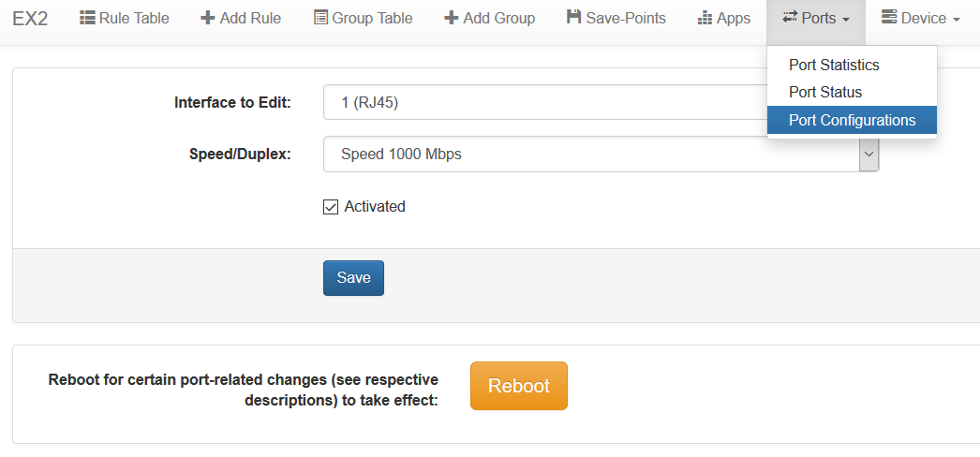
Port Configuration
Specify port settings
Select port to configure (1-n)
Select speed and duplex
Activate/Deactivate port
Reboot is required when Port 5 and/or Port 6 is changed from 1G to 10G or 10G to 1G

Slide 26
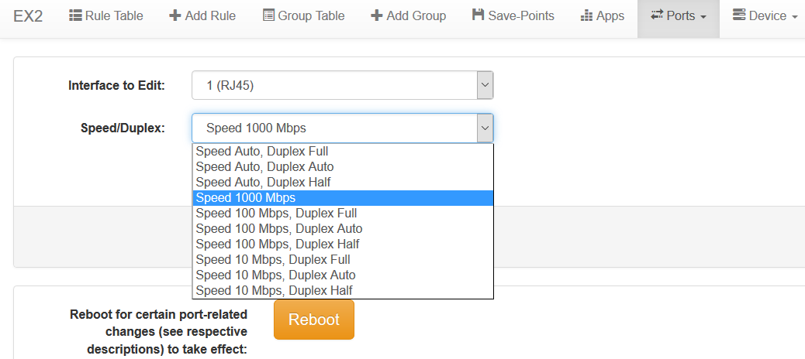
EX2 Port Speed and Duplex
Ports 1 to 4 (RJ45 Ports)

Slide 27
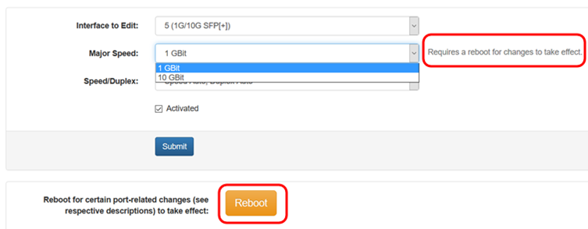
EX2 Port Speed and Duplex
Ports 5 and 6 (SFP Ports)
  Speed 1G or 10G – change requires a reboot!

Slide 28
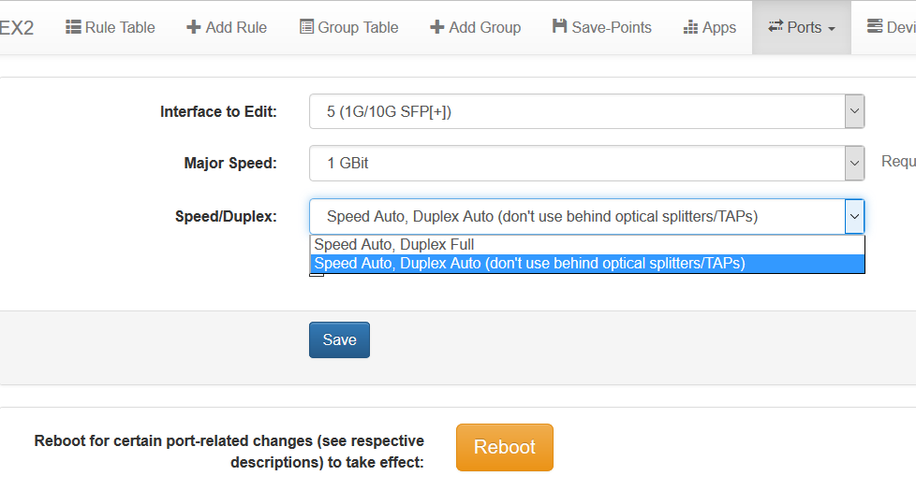
EX2 Port Speed and Duplex
Ports 5 and 6 (SFP Ports)
  Speed and Duplex
Autoneg OFF mode must be used behind optical splitters; the link is established even without receiving Autoneg.
Autoneg ON mode: Receiving link is established only if the Autoneg from the link partner is received.

Slide 29
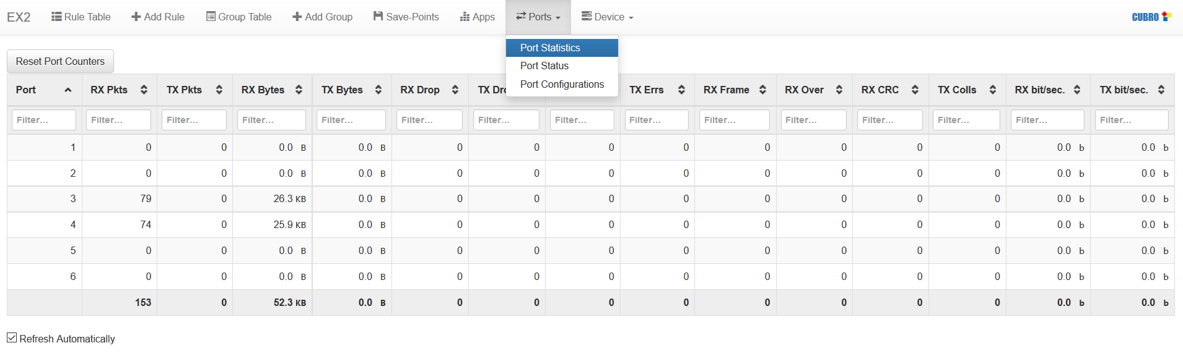
Port Statistics
Port Statistics can be viewed and reset.
Summed result

Slide 30
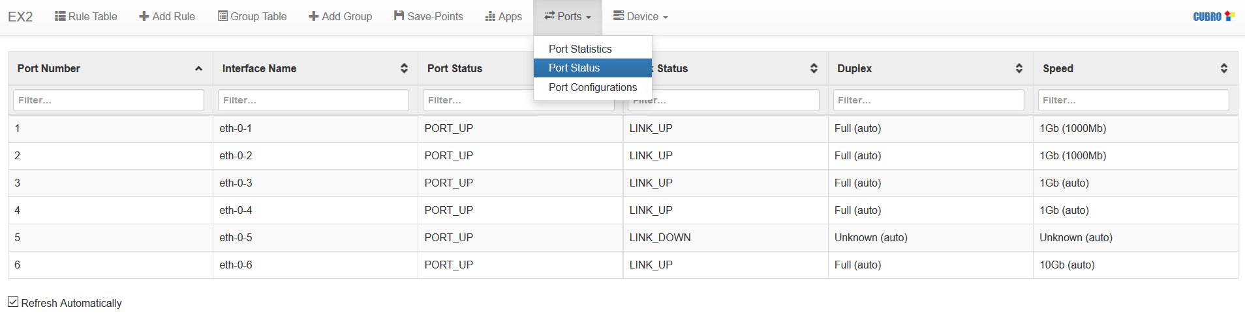
Port Status
Displays current status for all ports.
When Port is activated the Port Status is "PORT_UP"

Slide 31
Functionality (Filtering, …)

Slide 32
Filter Rules - Outline
Priority
Filter/Match
Action
Rules are applied in order of the priority.
  Priority is set for every rule;
  range between 0 (lowest) and 65535 (highest).
  Default priority is 32768.
Once a packet satisfies a matching filter the corresponding action is performed; the packet is no longer available for filtering.
  If two filters would match only the higher priority is applied!
If a packet does not satisfy a matching filter the packet is dropped.

Slide 33
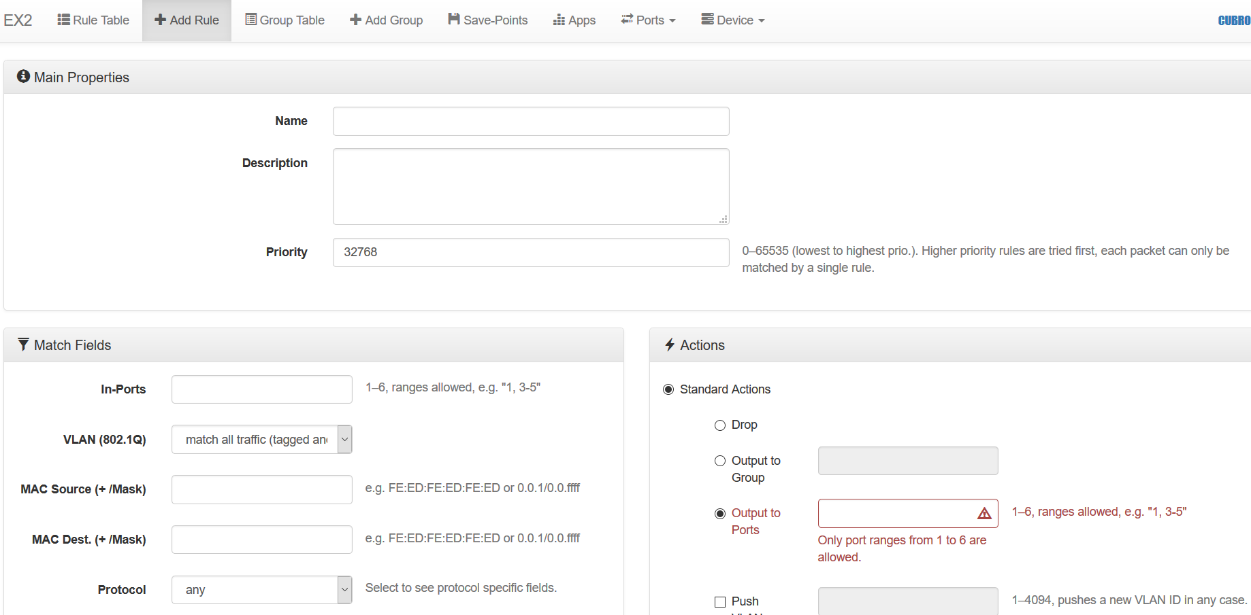
Entering Rules 1 – General Parameters
Click the "Add Rule" tab to enter new rules.
User-defined name of the rule
Detailed description of the rule
Rule Priority – to stack rules; Default Priority is 32768
Defines the Filter criteria
Defines the Action i.e. what should happen to the matched traffic

Slide 34
Rule - Priority
The Cubro Packetmaster does not allow handling of an incoming packet twice. Once the packet matches a rule the packet is processed and there is no second opportunity to process this packet.
The priority field is a way to stack rules. The priority value can be anything between 0 and 65535. A higher value will match before a lower one.

Slide 35

Stacking of Rules / Overlapping Flows
Required Functionality
Port 1: input
Port 2: input
Port 5: output – aggregate VLAN ID 100 traffic from Port 1 to 4
Port 6: output – aggregate all traffic from port 1 to 4
Rules/Flows:
All traffic incl. VLAN ID100
Only VLAN ID100
Priority
Filter/Match
Action
40000
input=1,VLAN=100
Output=5&6
40000
input=2,VLAN=100
Output=5&6
30000
input=1
Output=6
30000
input=2
Output=6

Slide 36
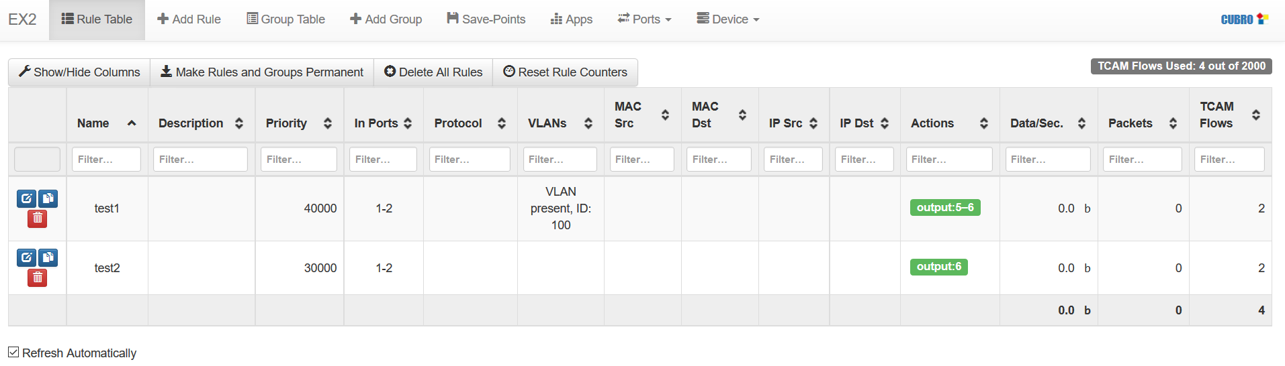
Stacking of Rules / Overlapping Flows
Required Functionality
Port 1: input
Port 2: input
Port 5: output – aggregate VLAN ID 100 traffic from Port 1 to 4
Port 6: output – aggregate all traffic from port 1 to 4
All traffic incl. VLAN ID100
Only VLAN ID100

Slide 37

Traffic inside Packetmaster
Priority 65535
Priority 65534
Priority 65533
Priority 65532
Priority 65531
Priority 65530
Priority 00001
Priority 00000
CRC check
Filter 1
Filter 2
Filter 3
Filter 4
Filter 5
Filter 6
Filter
Filter n
No match
Action 1
Action 3
Action n
First matching filter processes the packet

Slide 38
Overlapping Filters
All traffic
http traffic only
Only one IP inside http
Sometimes the same traffic is desired at multiple outputs.
  Assign highest priority to smallest traffic portion
  (most detailed filter criteria)
  Send traffic to all other ports where needed
  Continue with setup for other filters
Output 1
Output 1,2
Output 1,2,3
60000
input=6,IP, TCP Port 80
Output=1,2,3
50000
input=6,TCP Port 80
Output=1,2
40000
input=6
Output=1

Slide 39
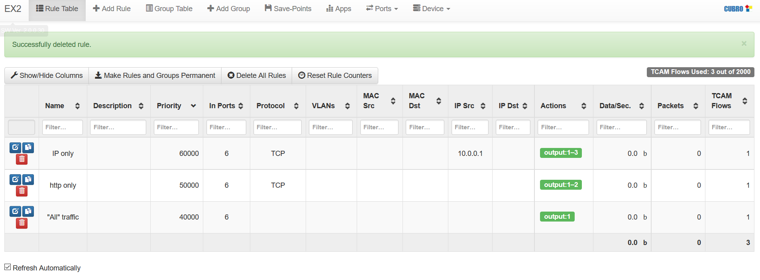
Overlapping Filters
60000
input=6,IP, TCP Port 80
Output=1,2,3
50000
input=6,TCP Port 80
Output=1,2
40000
input=6
Output=1

Slide 40
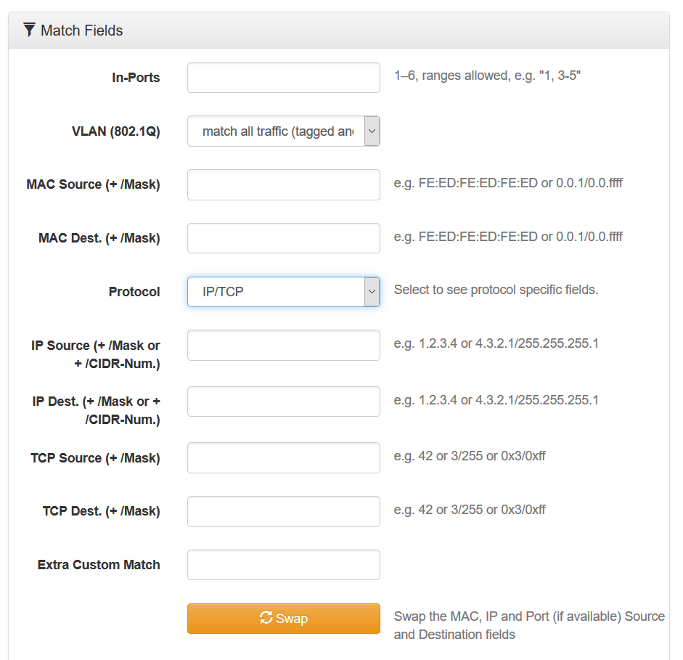
Entering Rules 2 – Match Fields
Select ports to apply rules
Separator e.g. 1,3 or ranges e.g. 2-4
If empty the rule is valid for any incoming traffic → valid for all inputs
If VLAN filtering is required chose “match tagged traffic only”
IP masks are entered in CIDR notation – e.g. /24

Slide 41
Match Fields – important
Empty fields are like a wildcard and
not considered further → to be considered as any value
To filter out a full duplex communication requires two filter rules.
Aggregated output
32768
input=1
Output=2,3
32768
input=2
Output=1,3

Slide 42
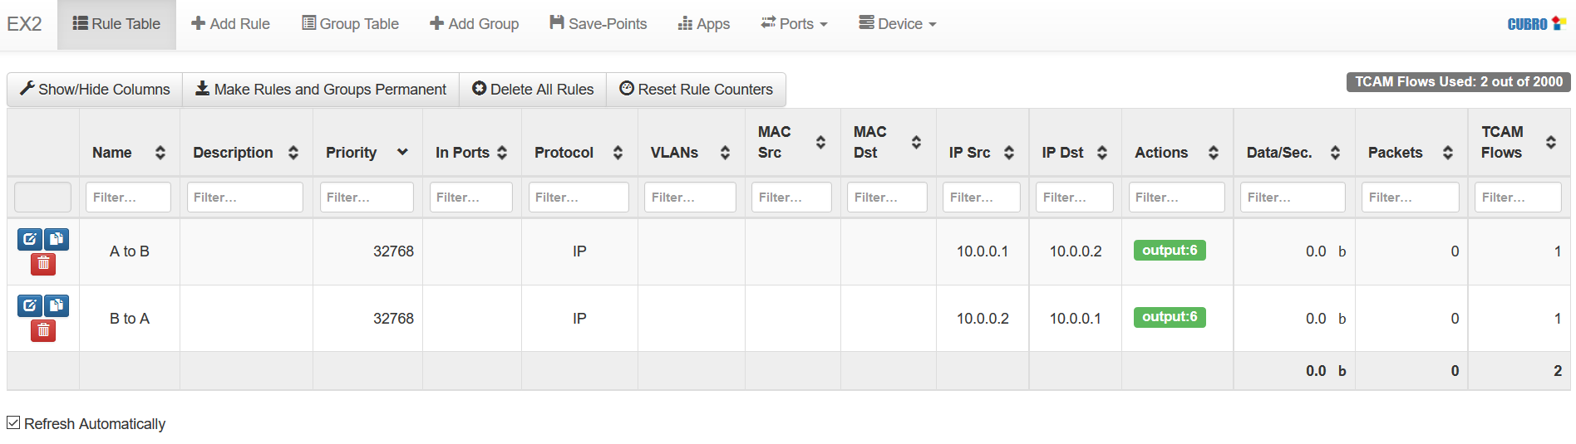
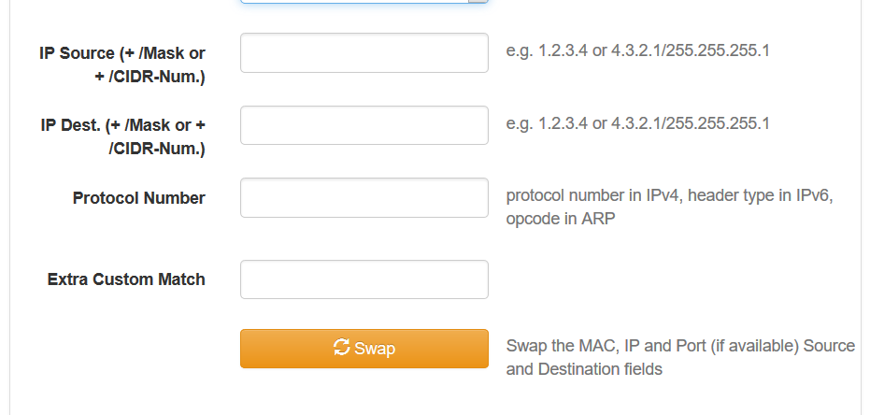
Match Fields - Examples
Filter out full communication of IP 10.0.0.1 to 10.0.0.2 → 2 Filters required
Use the Swap Button to
exchange Source and
Destination

Slide 43
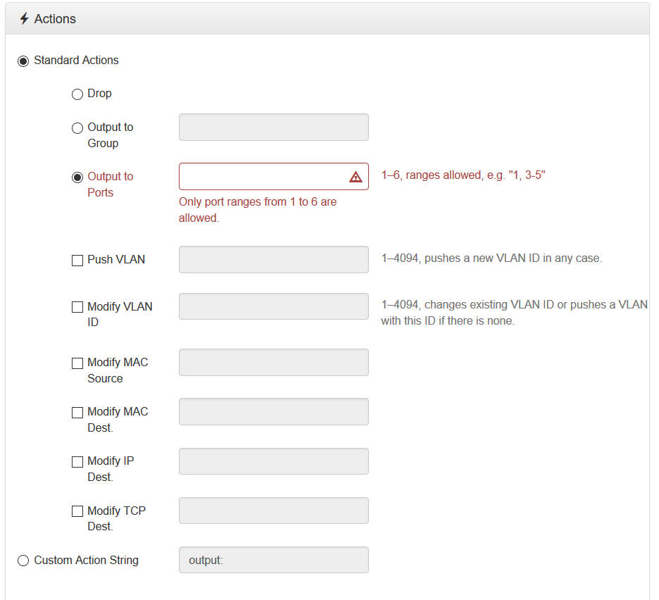
Entering Rules 3 - Actions
Removes matched packets
Sends packets to a group of ports – required for Load-Balancing (see later)
Selects output ports for matching packets
Separator e.g. 1,3 or ranges e.g. 2-4. Note that each defined Port carries the same traffic.
Additional actions to output action – modifies the packet; e.g. adds a VLAN tag

Slide 44

Match+Actions - Example
Problem: How to identify on an aggregated output at which port the traffic originally arrived?
Solution: Use VLAN Push function. Add a specific VLAN tag on each input port.
Aggregated output
incl. VLAN IDs for identification
32768
input=1
Output=6 + VLAN ID 101
32768
input=2
Output=6 + VLAN ID 102
32768
input=3
Output=6 + VLAN ID 103

Slide 45
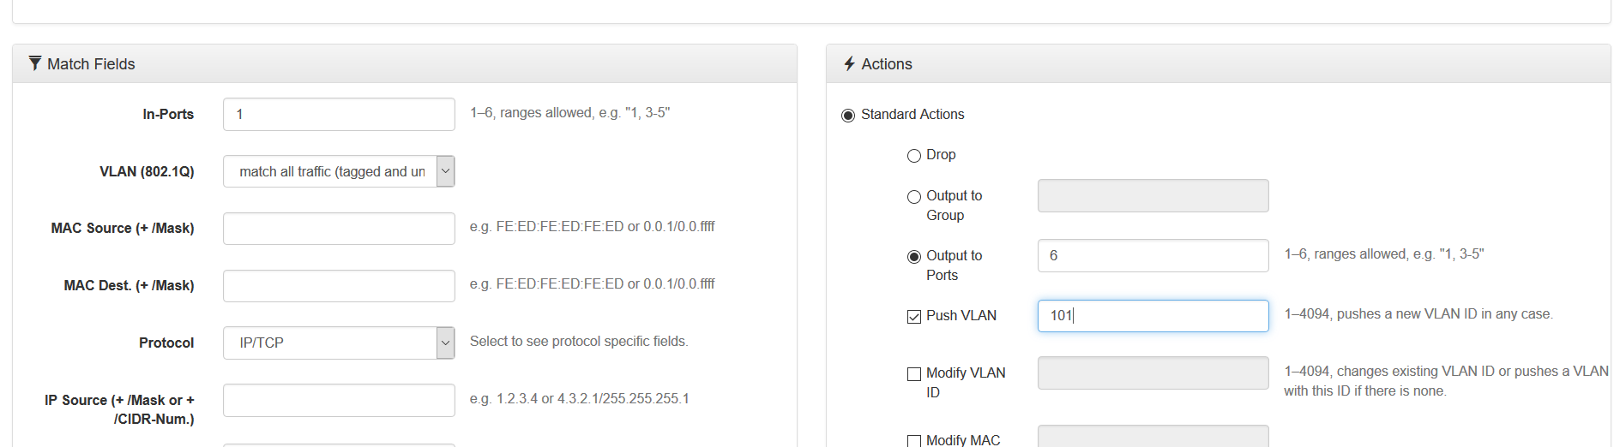
VLAN push
32768
input=1
Output=6 + VLAN ID 101
32768
input=2
Output=6 + VLAN ID 102
32768
input=3
Output=6 + VLAN ID 103

Slide 46
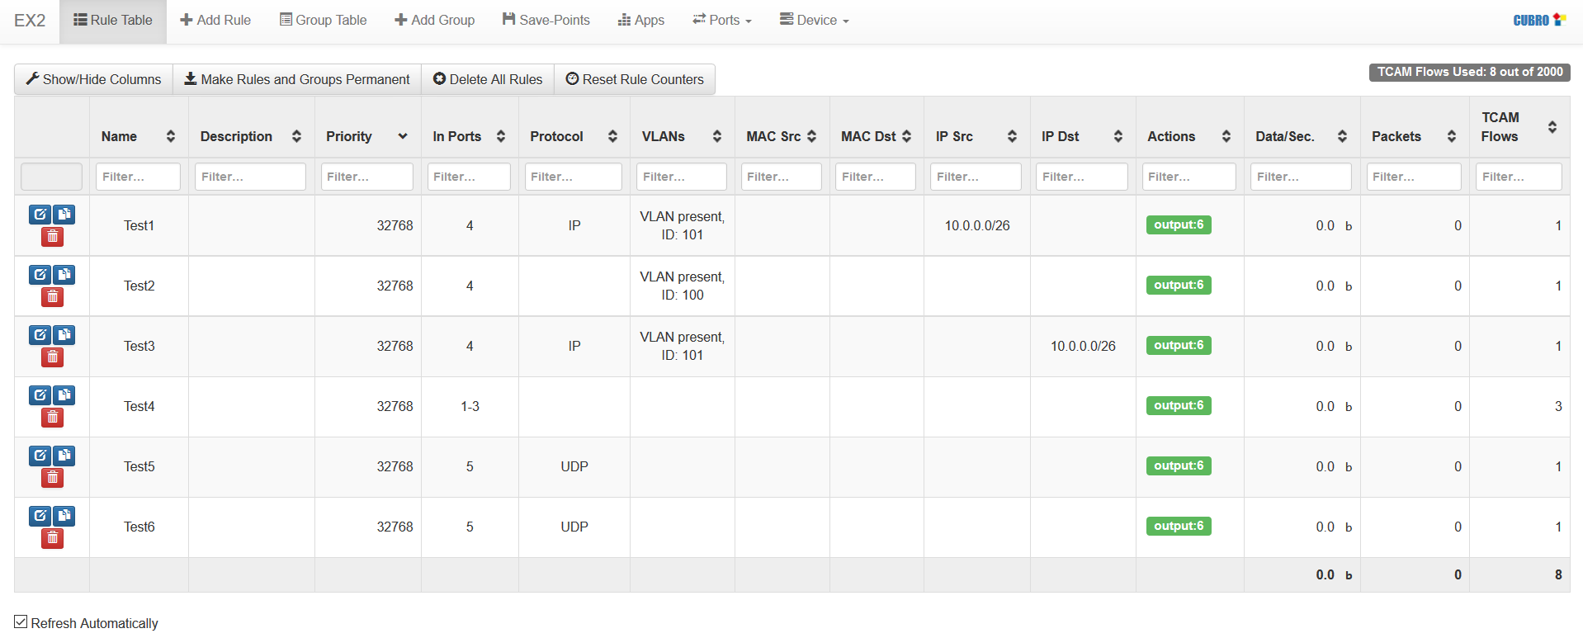
Rule Table 1
Shows total number of flows/rules used
Click "Rule Table" to display all active rules.
Summed result

Slide 47
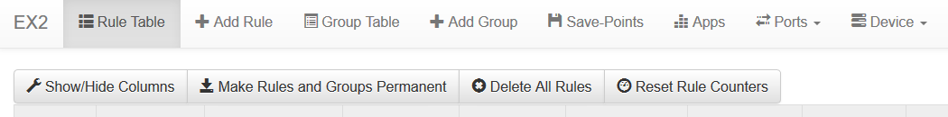
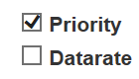
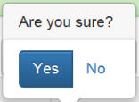
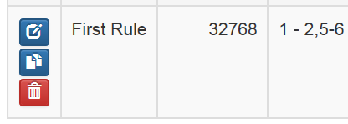
Rule Table 2
Hides/Unhides columns
e.g.
Saves rules to the Quicksave memory – see chapter “Save-Points”
Note: If rules are not saved and the unit is rebooted the rules are deleted.
Deletes all active rules.
Stored rules are not deleted!
Resets all counters in "Rule Table"
Editing/Copying/Deleting Rules
Edit rule (only Output Actions can be edited)
Create new rule using the current one as basis
Delete this rule

Slide 48
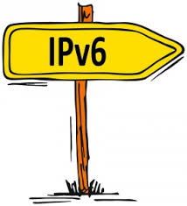

Packetmaster EX
IPv6 Filtering

Slide 49
IPv6 Filtering - Overview
In the default configuration the Packetmaster EX allows IPv4 Filtering only.
In the default configuration IPv6 Packets can be
  Aggregated
  Filtered for Layer 2 parameters (MAC and VLAN). IPv6 Address and/or UDP/TCP Port Numbers; filtering is not possible.
To filter on IPv6, the Database (DB) mode needs to be changed. Afterwards IPv6 filtering is possible.

Slide 50
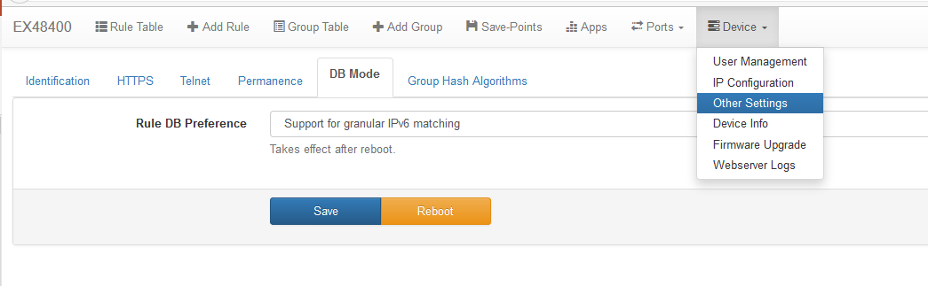
Change DB Mode to IPv6
Go to Device – Other Settings – DB Mode and select “Support for granular IPv6 matching” and press “Save” then “Reboot”.
After the reboot the unit is able to handle IPv4 and IPv6 traffic and filtering as well.

Slide 51
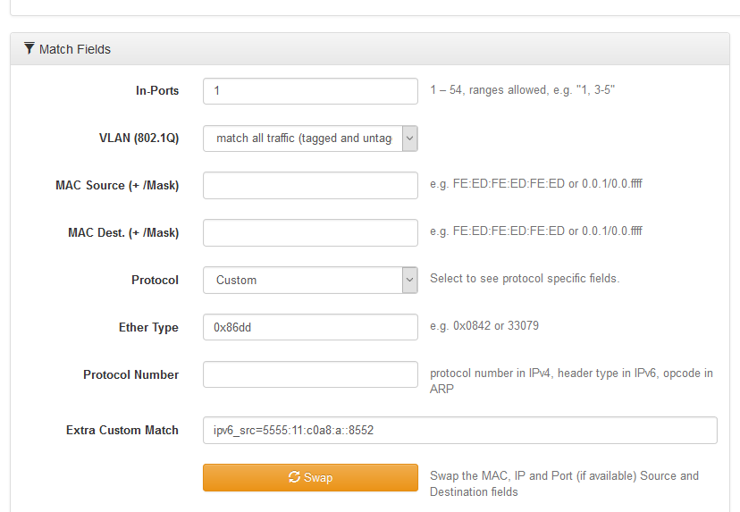
IPv6 Address Filtering
Select Add Rule and change Match Fields
needs to be set to Custom
needs to be set to 0x86dd which means IPv6
needs to be set to
ipv6_src = Source Address
ipv6_dst=Destination Address

Slide 52
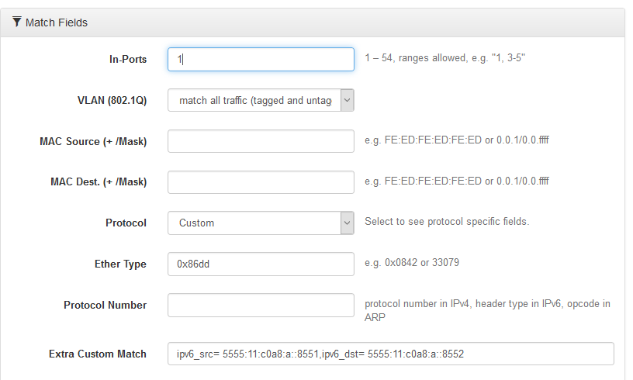
Example:
Source & Destination Filter
Source: 5555:11:c0a8:a::8551
Destination: 5555:11:c0a8:a::8552
Extra Custom Match:
  ipv6_src=5555:11:c0a8:a::8551,ipv6_dst=5555:11:c0a8:a::8552

Slide 53
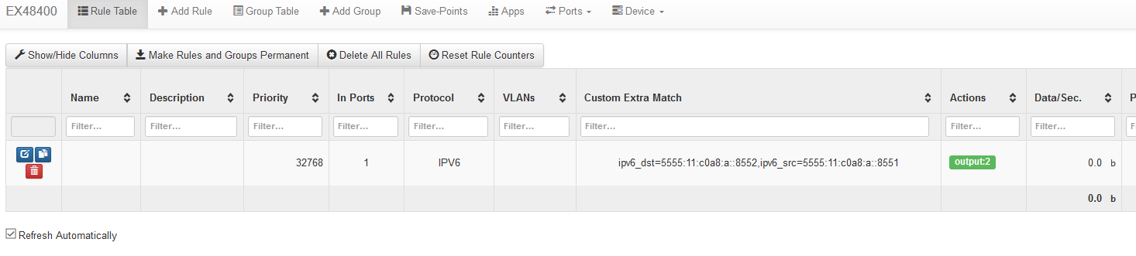
Rule Table View
Rule Table shows the IPv6 filter correctly

Slide 54
TCP/UDP Filtering on IPv6 traffic
Extra Custom Match
  udp6 for UDP or use Protocol Number 17
  tcp6 for TCP or use Protocol Number 6
  tp_src=<Source Port Nr.> or use
    udp_src=<UDP Source Port Nr.>
    tcp_src=<TCP Source Port Nr.>
  tp_dst=<Destination Port Nr.> or use
    udp_dst=<UDP Destination Port Nr.>
    tcp_dst=<TCP Destination Port Nr.>

Slide 55
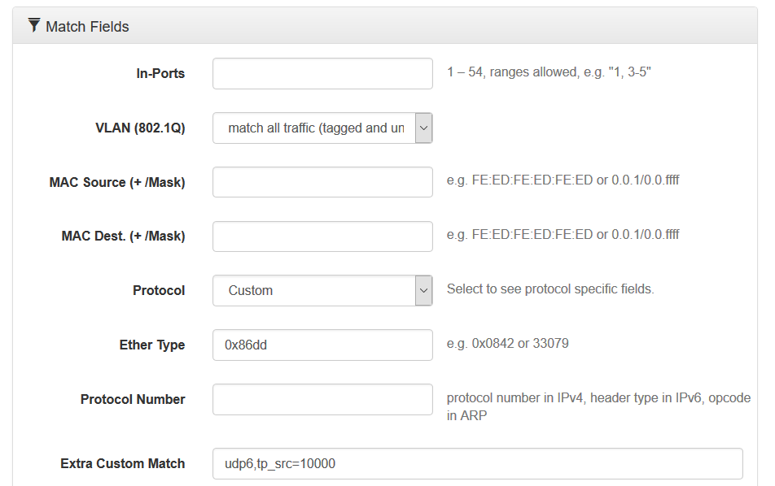
Example:
UDP Source Port Filter
UDP Source Port: 1000
Extra Custom Match:
  udp6,tp_src=10000

Slide 56
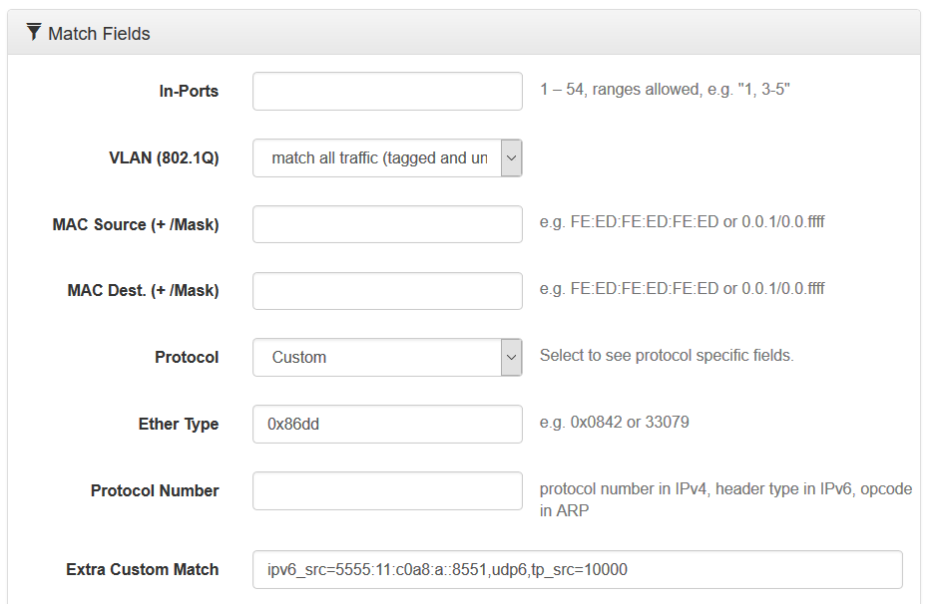
Example:
Address and Port Filter

Slide 57
IPv6 Summary
Protocol set to Custom
EtherType set to 0x86dd
Extra Custom Match
  IPv6 Destination: ipv6_dst=<ipv6/netmask>
  IPv6 Source Address: ipv6_src=<ipv6/netmask>
  UDP: udp6
  TCP: tcp6
  Source Port: tp_src=<Port Number>
  Destination Port: tp_dst=<Port Number>

Slide 58
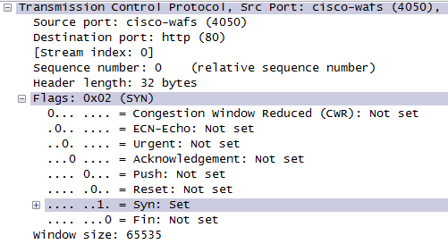
Packetmaster EX
TCP Flag Filtering

Slide 59
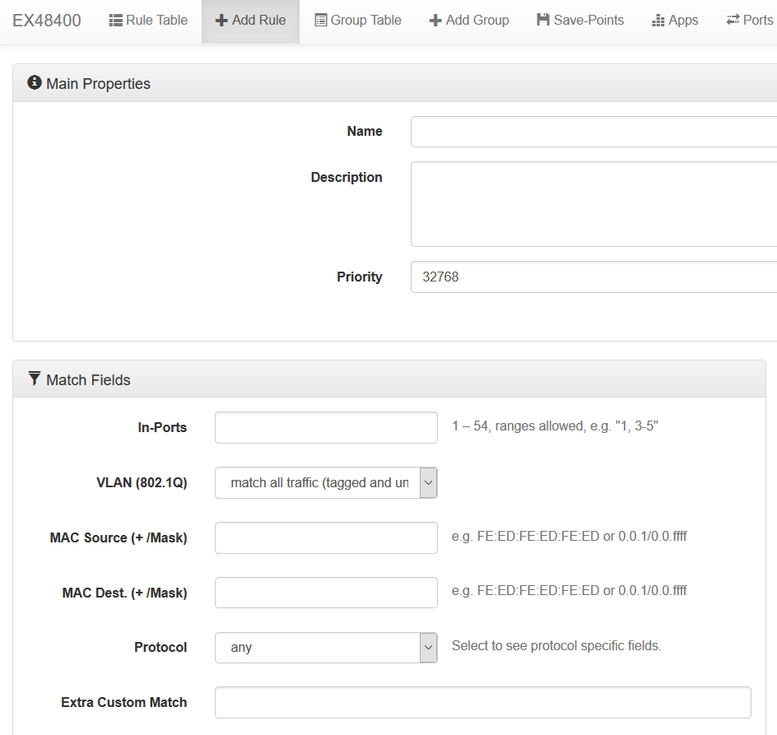
TCP Flag Filtering
Packetmaster EX allows the user to filter on TCP Flags such as SYN, ACK, RST, etc.
To use this capability via the Web GUI of the EX we have a special field called Extra Custom Match that is located in the Add Rule menu.

Slide 60
TCP Flag possibilities
EX supports a bitwise match on the TCP flags including a mask. The flags and mask are 16-bit numbers written in decimal or in hexadecimal prefixed by 0x. Each1-bit in mask requires that the corresponding bit in flags must match. Each 0-bit in mask causes the corresponding bit to be ignored.
Alternatively, the flags can be specified by their symbolic names, each preceded by either + for a flag that must be set, or - for a flag that must not be set, without any other delimiters between the flags. Flags not mentioned are considered wildcards. For example, tcp_flags=+syn-ack matches TCP SYNs that are not also ACKs.

Slide 61
Symbolic Names
TCP protocol currently defines 9 flag bits, and additional 3 bits are reserved (must be transmitted as zero), see RFCs 793,3168, and 3540. The flag bits are, numbering from the least significant bit:
Bit | Symbolic Name | Description
0 | fin | No more data from sender
1 | syn | Synchronize Sequence Numbers
2 | rst | Reset the connection
3 | psh | Push function
4 | ack | Acknowledgement field significant
5 | urg | Urgent pointer field significant
6 | ece | ECN Echo
7 | cwr | Congestion Windows Reduced
8 | ns | Nonce Sum
9-11 | - | Reserved
12-15 | - | Must be zero

Slide 62
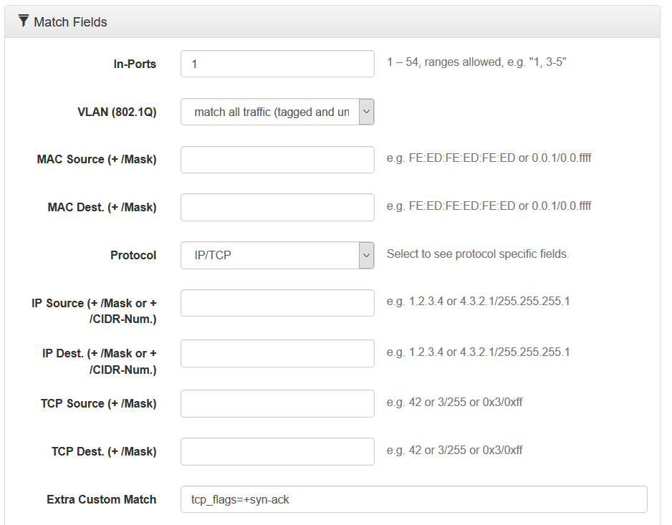
Use of Extra Custom Match
needs to be set to IP/TCP
needs to be set to tcp_flags=<symbolic name>
+syn-ack means that it filters out all syn messages that are not acknowledged.

Slide 63
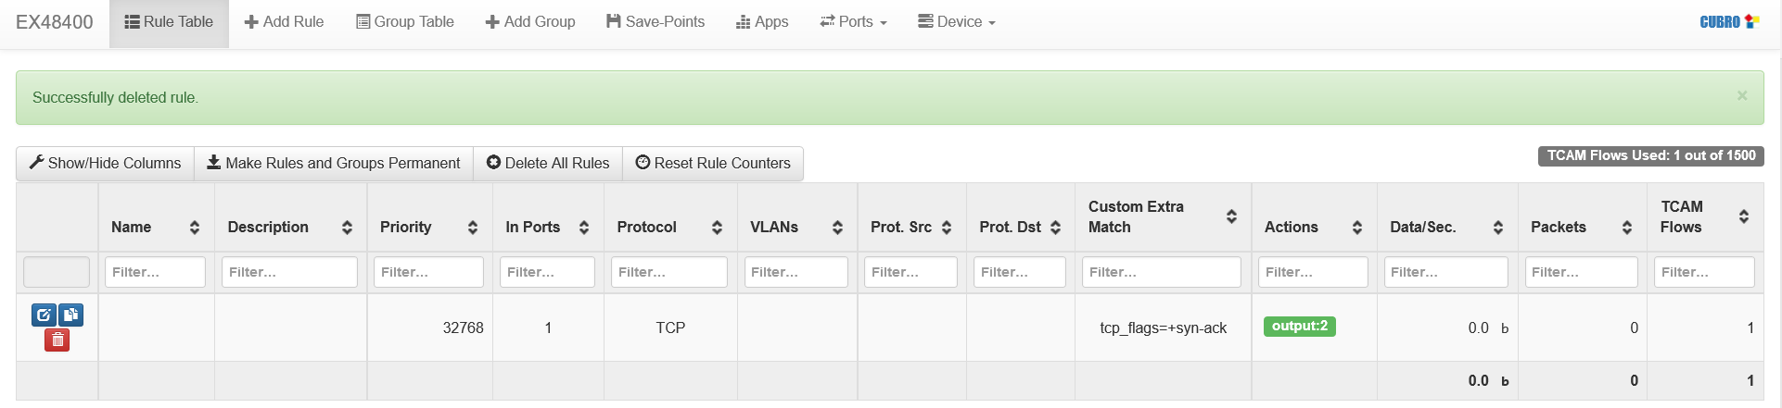
Rule Table View
Rule Table shows the filter correctly.

Slide 64
Group Settings (Load-Balancing)

Slide 65
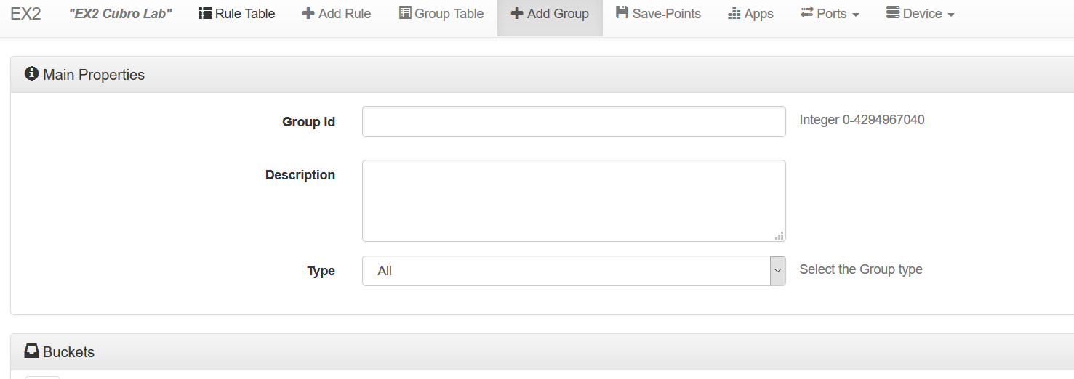
+Add Group and Group Table
"+Add Group" – allows the user to define a group of ports e.g. for load-balancing applications.
Group Table – shows the defined groups

Slide 66
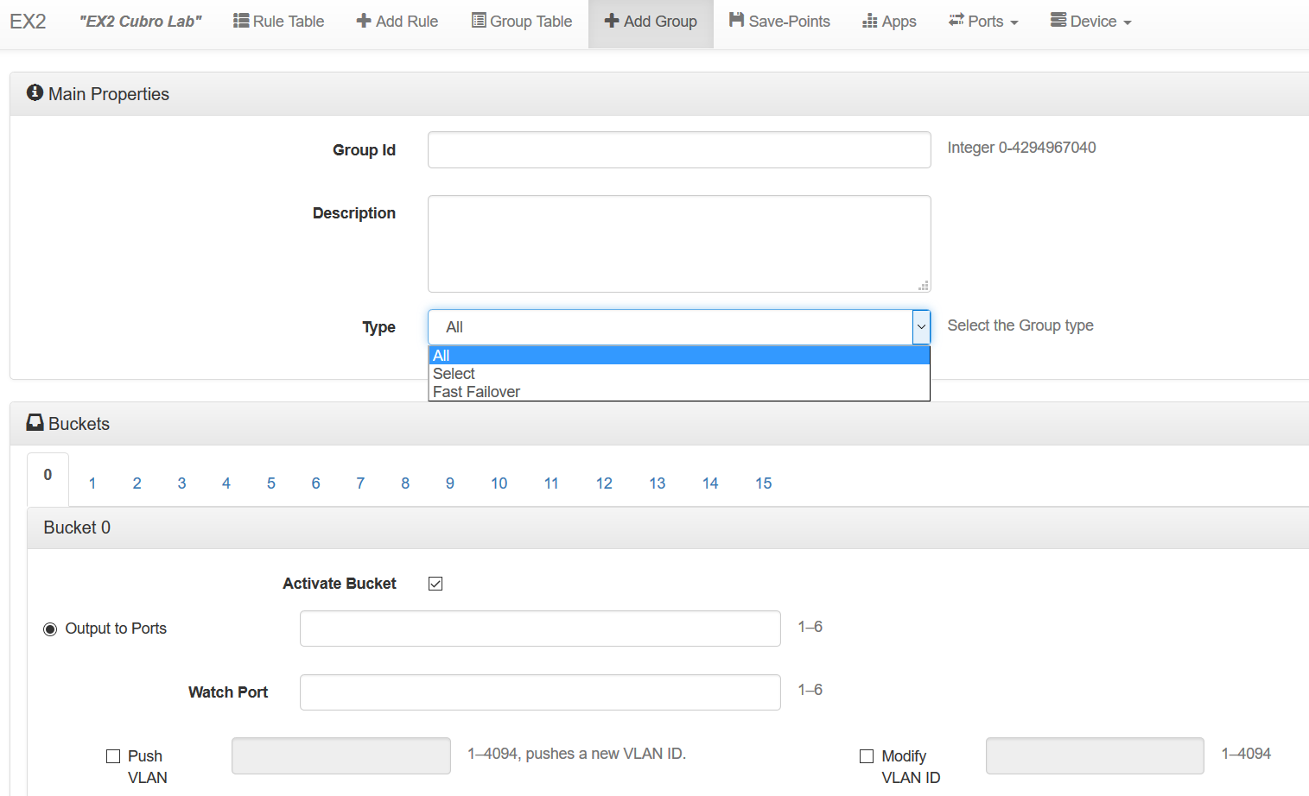
+Add Group
Select a Group ID. Important because a rule needs to be defined that uses this ID as an action.
Defines the type of group. For load-balancing "Select" has to be used.

Slide 67
Load-Balancing via Select Group
e.g. Ports 1 through 4 should load-balance the traffic that is received by Port 6
Steps
  Define Group ID=1 as Type=Select with P1 to P4
  Define Load-Balancing Hash-Key
  Verify Group Settings via Group Table
  Define rule from P6 to Group ID1

Slide 68
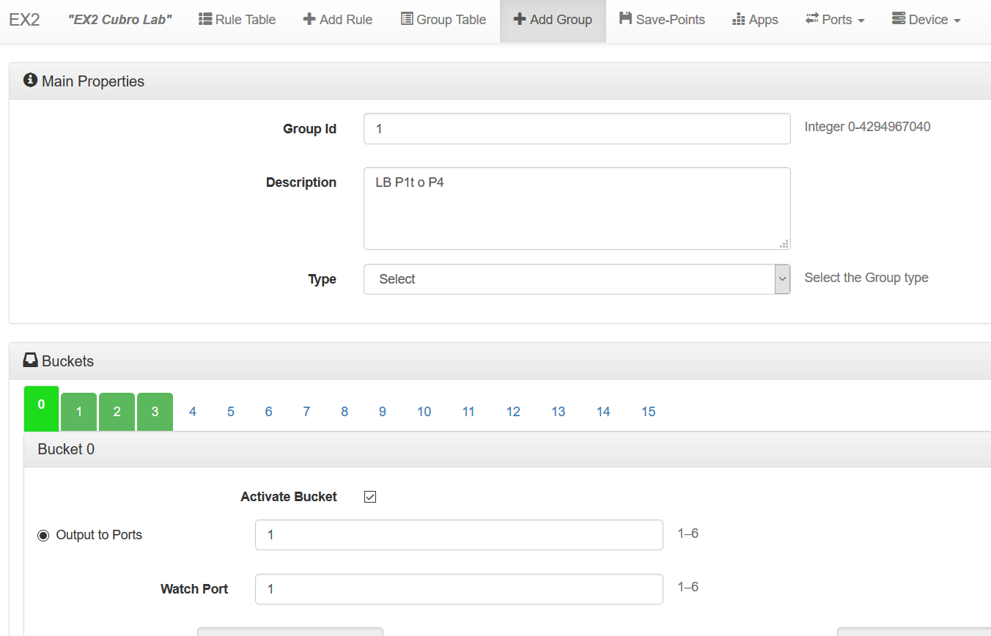
Group Definition
Green color shows that the bucket is correctly defined.
Important: for load-balancing the type needs to be "Select".
Traffic is only forwarded to the relevant output port if the watch port status is "Link-Up". Usually the “Output to Ports” and "Watch Port" are set to the same value. If the "Watch-Port" status is "Link-Down" the traffic is forwarded to another port within the group.
Set the output port of each bucket = set the ports that belong to this group.

Slide 69
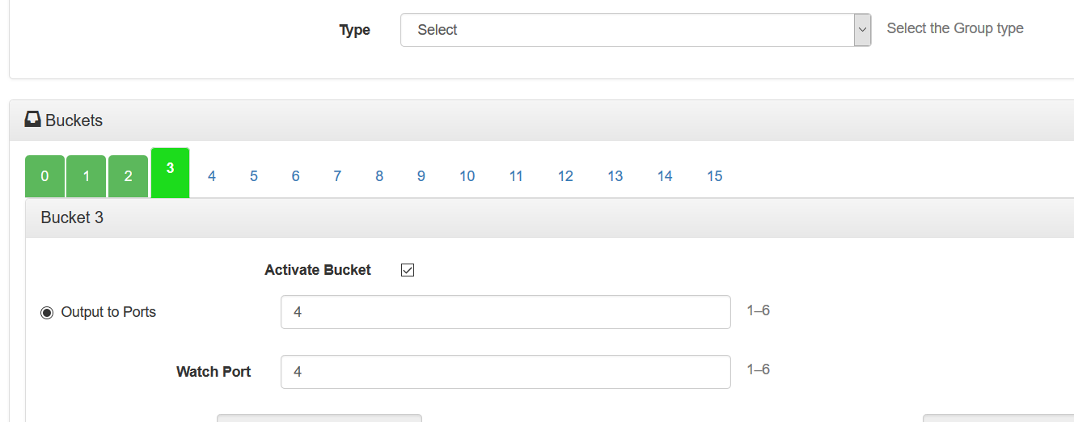
Group Definition
A group can include up to 16 ports (buckets 0 through 15).
Traffic is distributed within the ports of the group.
Distribution is based on a calculated hash-key.
Hash-key calculation criteria is user selectable

Slide 70

Group Table
Verify the group settings
Change hash-key
Opens Hash-key settings.
Select means that a packet is handled only by a single action. Either sent to P1 or P2 or P3 or ‘’P4

Slide 71


Hash-Key
Hash-Key settings are found in "Device" – "Other Settings" – "Group Hash Algorithms"
opens up
Selectable Hash-key criteria

Slide 72
Session-aware Load-balancing
Session-aware = every packet that belongs to the same conversation is sent to the same physical output port within the group.
Conversation association is done by examining selected fields within each packet and performing a mathematical algorithm called hash key calculation to consistently separate and distribute traffic to specific ports within a load balanced group.
Packets that result in the same Hash-key value are always sent to the same physical output port.

Slide 73


Hash-key example for IP Source Address

Slide 74


Hash-key for two or more criteria
Hash value is calculated over both fields
As a result the hash-key is the same for both directions → Layer 3 session aware !

Slide 75

Define Rule to forward traffic to Group

Slide 76

Additional Group Actions
In addition to straight output of a packet it is also possible to modify the packets.

Slide 77

Filtering and Load-balancing
Filtering and load-balancing is possible at the same time.
Filtering is done at the inputs and only filtered packets will be further processed.
Only packets arriving at P1 with IP Source 10.0.0.1 will be sent to group 1

Slide 78

Other Group Types
ALL actions will be executed simultaneously. Traffic arriving will be sent out at P1 AND P2 and at the same time the IP Destination will be changed to 20.0.0.1 for P1 and to 20.0.0.2 for P2.
FF = Fast Failover; Traffic is sent to P1. If P1 goes down the traffic is sent to P2.

Slide 79
Save Setups

Slide 80


Save-Points
Save-Points allow the user to save rules and port settings.
Saves Rule Configuration
Saves Port Configuration
Download a Save-Point to the EX2
Rules that are saved via “Make Rules and Groups permanent” in the Rule Table menu
Exports the selected Save-Point for backup purposes
Select which Save-Point is loaded after a reboot

Slide 81
Applications (Apps)

Slide 82

Apps - Applications
Apps are special pieces of software that run inside the EX2 and in parallel to the standard Packetmaster Software.
Configures the App

Slide 83

Heartbeat App

Slide 84

SNMP App
Runs a SNMP server and sends SNMP traps to a SNMP receiver

Slide 85

ARP Responder App
Responds to ARP requests. Used in GRE encapsulation/decapsulation applications.

Slide 86


Reset SFP App
IP Adress:
  IP: 192.168.2.250
  Maske: 255.255.255.0
  Gateway : 192.168.2.1
Port Setup:
  P1 bis 4: Autoneg ON
  P5 und 6: 1G
Default Flows/Filter:
  P1 <-> P2; aggr. auf P3
  P5 <-> P6; aggr. auf P4

Slide 87

Heartbeat Bypass App
EX2 controls a Cubro Bypass Switch

Slide 88

Heartbeat Bypass App

Slide 89

Functions not available in the Web GUI
Please note that not all functions of the EX2 are implemented in the Web GUI.
Full functionality like GRE encapsulation/decapsulation or sFlow generation of the EX2 is available via SSH CLI access.
Contact us if you need more details.

Slide 90

Cubro Support Portal
Register at the Cubro Support Portal – http://support.cubro.com
Get access to our technical support engineers

Slide 91

Contact Information
If you have any additional question or need help contact us.
Cubro Acronet GesmbH
Geiselbergstr. 17/6.OG
1110 Vienna
Austria
Tel.: +43 1 29826660
Fax: +43 1 2982666399
Email: support@cubro.net
www.cubro.net

